Slide 1

ONLINE SHOPPING
EASY BUY
Team Members :
Revanth Pasupula - 46336094
Nishat Anjum - 46334030
Kavya A M - 46336023
Narmadha M - 46335970
Pavani Sankranthi - 46336025

Slide 2
CONTENT :
Tech Stack Overview
Functional Requirements
Non-Functional Requirements
ER Diagrams
Class Diagram
Sequence Diagram
Application layers
User & Admin Diagram
Problem Statement
Future Enhancements

Slide 3
Tech Stack Overview
Technologies Deployed in Our Project
JDK17
Spring and Spring Boot
Postman
PostgresSql
Junit Mockito
Dependencies used in Spring Boot:
Spring Web
Spring Data Jpa
PostgreSQL Driver
Project
Maven

Slide 4
Functional Requirements
Allow Users to register and create accounts, log in with their credentials. Implement roles and permissions for different user types (e.g., user, admin).
Allow Admin to Add, edit, and delete products, Categorize products into different categories
Allow Users to add products to a shopping cart, Support multiple items and quantities in the cart and remove items from the cart.
Allow User view cart and total orders.
Allow User to Implement search functionality for products, Provide filtering options for users to find products easily.
Enable users to update their profiles and account information like View their Profile , Delete their account

Slide 5
Non-Functional Requirements
Application is user-friendly.
All major actions performed must be traceable
Logs related to all major events including errors must be recorded in date based log files
Application should load faster and easily scalable.
Design should be flexible enough to move application components to different tiers

Slide 6
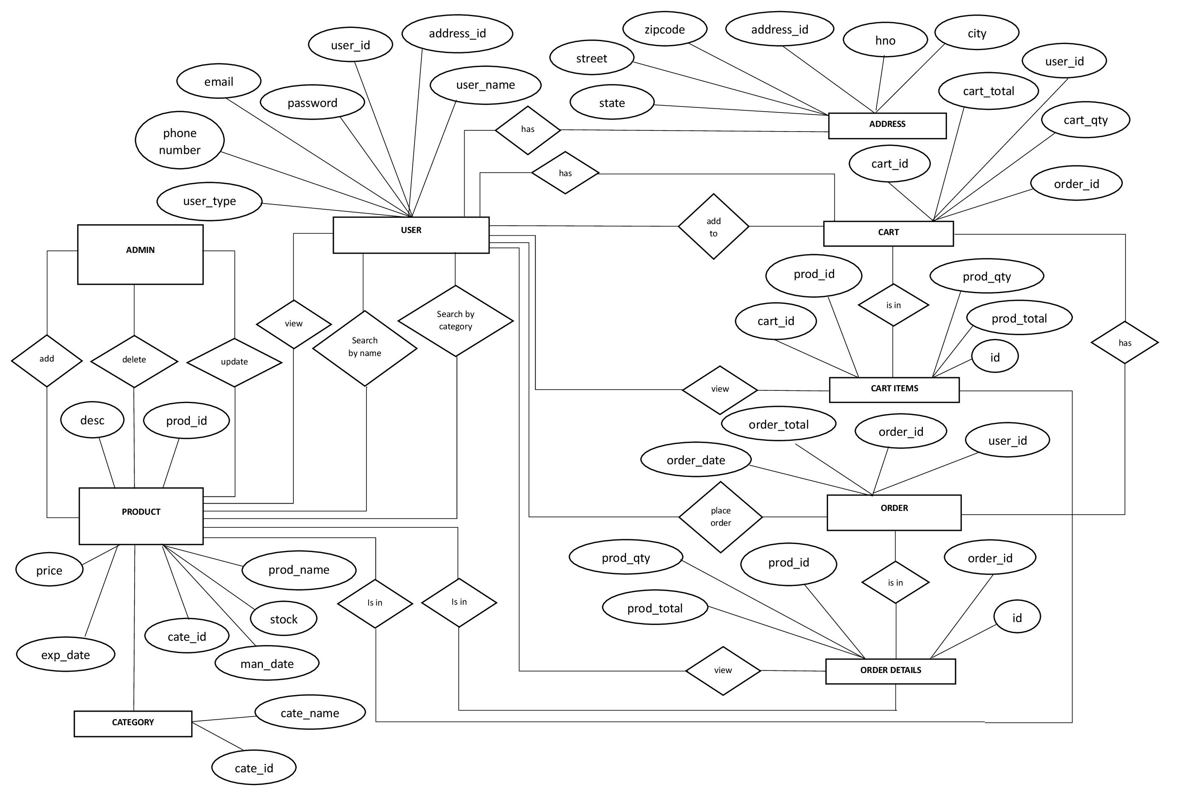
ER DIAGRAM

Slide 7
CLASS DIAGRAM
<
USER
- user_id : int
- user_email : char
- user_password : char
- user_phoneNumber : bigint
- user_name : char
- user_type : char
- address_id : int
+ register() : public
+ login() : public
+ updateProfile() : public
+ deleteProfile() : public
+ resetPassword() : public
PRODUCTS
- product_id : int
- product_desc : char
- Product_expiry_date : date
- Product_manufacture_date : date
- product_name : char
- product_price : double
- product_stock : int
- category_id : int
- user_id : int
+ viewProduct() : public
+ viewProductByCtegory() : public
+ viewProductByName() : public
ORDER DETAILS
- id : int
- quantity : int
- total : double
- order_id : int
- product_id : int
CATEGORY
- category_id : int
- category_name : char
<
<
<
PRODUCT IN CART
- id : int
- product_quantity : int
- product_total : double
- cart_id : int
- product_id : int
>
<
<
CART
- cart_id : int
- cart_quantity : int
- cart_total : double
order_id : int
user_id : int
+ addToCart() :public
+ ViewCart() : public
+ updateCart() : public
+ removeCart() : public
Admin
- user_id : int
- user_email : char
- user_password : char
- user_phoneNumber : bigint
- user_name : char
- user_type : char
- address_id : int
+ addProduct() : public
+ updateProfile() : public
+ deleteProfile() : public
ADDERSS
- address_id : int
- city : char
- house no : char
- State : char
- street : char
- zipcode : int
ORDERS
order_id : int
order_date : date
order_total : double
user_id : int
<
<

Slide 8
SEQUENCE DIAGRAM
User
Admin
Online Shopping
AddProduct()
UpdateProduct()
AdminOperation
DeleteProduct()
Register()
RetriveInfo()
Login()
VerifyLogin()
View profile
Delete profile
ViewInfo()
Update Profile
ManageProfile()
View All Product
ViewProduct
Search product By name
Search Product By category
SearchingProduct
Add To cart
Remove from Cart
UpdateCart
Placing Order
OrderPlacing

Slide 9
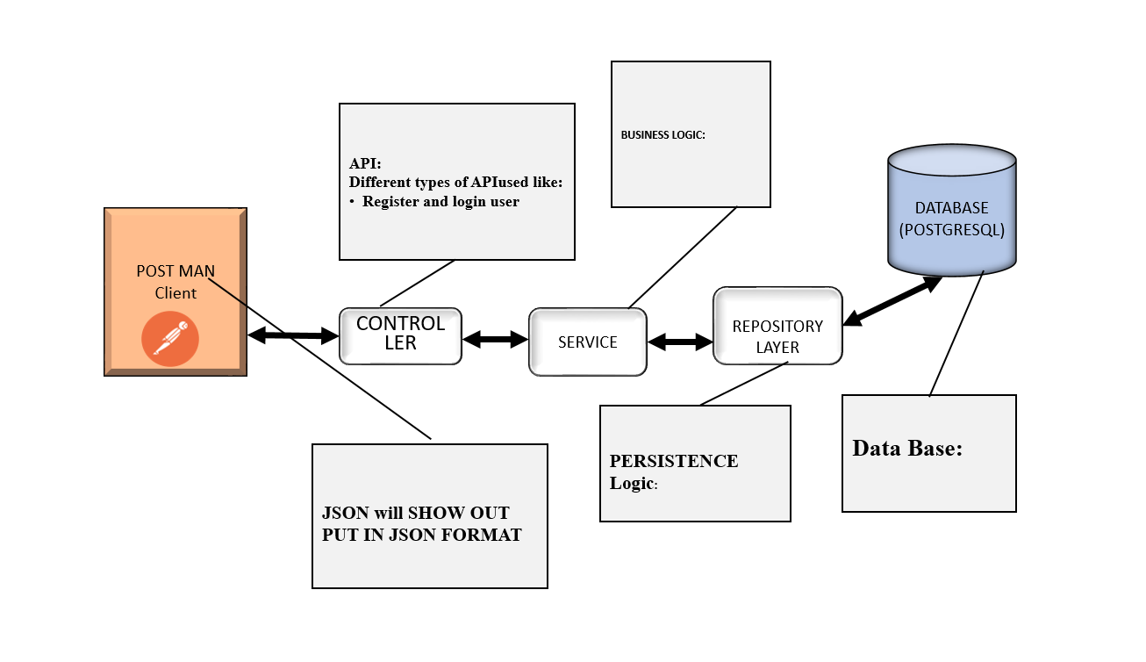
APPLICATION LAYER

Slide 10
USER & ADMIN DIAGRAM
REGISTRATION
LOGIN
VIEW_PROFILE
<<EXTEND>>>
<
<
ADD_PRODUCT
<<EXTEND>>>
UPDATE_PROFILE
DELETE_PROFILE
VIEW_ALL_PRODUCT
UPDATE_PRODUCT
<<INCLUDE>>>
ADD_TO_CART
<<INCLUDE>>>
<
SEARCH PRPODUCT_BY NAME
SEARCH PRODUCT_BY CATEGORY
USER
DELETE_PRODUCT
ADMIN
REMOVE_FROM_CART
PLACING_ORDER

Slide 11
Entities
User
Address
Product
Category
Cart
Cart Items
Order
Order Details

Slide 12

User Scope
Registration
Login
Products
Cart
Order details

Slide 13
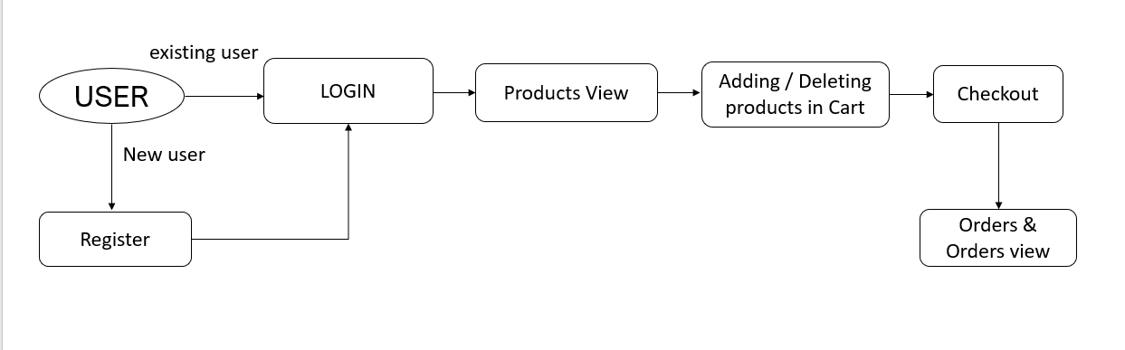
User :

Slide 14
Admin Scope
Adding the products
Deletion of products
Updating products

Slide 15
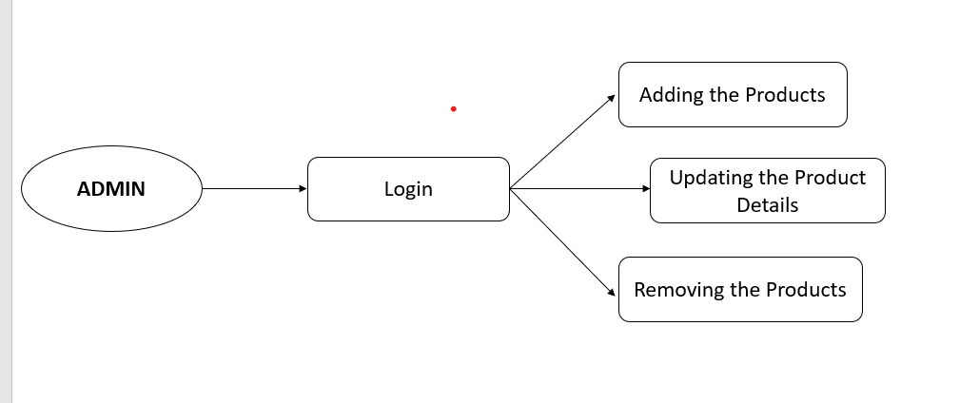
Screen Flow
ADMIN :

Slide 16
Problem Statement
Problem statements The system should allow the creation of new users in the system. It should be accessible by two kinds of users 1. The admin 2. The users.
The Online Shopping Application allows users to register and log in, browse a diverse product catalog, and add items to their shopping cart for a streamlined order process. Users can seamlessly purchase products, receive order confirmations, and manage their shopping experience. Additionally, the application offers educational tests with regularly updated categories and listings.
The admin should be able to upload the question bank. The admin should also be able to the tests and make changes accordingly. The admin should also manage the users.

Slide 17
Future Enhancements
User Reviews and Ratings : Allow users to leave reviews and ratings for products
Enhance the order tacking functionality for users and updates on the status of orders, from processing to shipping .
Implement a Wshlist Functionality feature where users can save products for future consideration and share their wishlists with others.
Introduce a system for discounts, promotions, and coupon codes. Allow admins to create and manage promotional campaigns.

Slide 18
Scrum Meeting
Daily we had discussed about the project and tasks assigned to our team members from day1 to day7.​
End of every day, we the whole team discussed in the class about the assigned task that had completed.​
We faced many challenges, and we approached in different ways to resolve the challenges that we faced.​

Slide 19

Thank You

